Slide 1
Agile & DevOps
By Muhammad Muneeb Ullah Khan

Slide 2
What is Software? Types of Software.
In a computer system, the software is basically a set of instructions or commands that tell a computer what to do.
For example like MS-Word, MS-Excel, PowerPoint, etc.
The two main types of software are system software and application software.

Slide 3
What is System Software?
These software programs are designed to run a computer's application programs and hardware. System software coordinates the activities and functions of the hardware and software. In addition, it controls the operations of the computer hardware and provides an environment or platform for all the other types of software to work in. The OS is the best example of system software; it manages all the other computer programs.

Slide 4
What is Application Software?
The most common type of software, application software is a computer software package that performs a specific function for a user, or in some cases, for another application. An application can be self-contained, or it can be a group of programs that run the application for the user. Examples of modern applications include office suites, graphics software, databases and database management programs, web browsers, word processors, software development tools, image editors and communication platforms.

Slide 5
Difference b/w Application Software & System Software:
System Software | Application Software
System Software maintains the system resources and gives the path for application software to run. | Application software is built for specific tasks.
Low-level languages are used to write the system software. | While high-level languages are used to write the application software.
It is general-purpose software. | While it’s a specific purpose software.
Without system software, the system stops and can’t run. | While Without application software system always runs.
System software runs when the system is turned on and stops when the system is turned off. | While application software runs as per the user’s request.
Example: System software is an operating system, etc. | Example: Application software is Photoshop, VLC player, etc.
System Software programming is more complex than application software. | Application software programming is simpler in comparison to system software.
The Software that is designed to control, integrate and manage the individual hardware components and application software is known as system software. | A set of computer programs installed in the user’s system and designed to perform a specific task is known as application software.

Slide 6
Characteristics of Software:
The characteristics of software play a vital role in software engineering, shaping the development, performance, and user experience of software systems. Functionality, usability, efficiency, flexibility, reliability, maintainability, portability, and integrity are key characteristics that software engineers should consider throughout the development lifecycle.

Slide 7
Functionality
Functionality is the primary characteristic of software that determines its ability to perform the tasks or functions it is designed for. It involves the features, capabilities, and behaviors that enable users to accomplish their goals using the software. It should meet the specified requirements and provide the desired functionality to address user needs effectively.

Slide 8
Usability (User-friendly)
Usability refers to how easily and efficiently users can interact with the software to achieve their objectives. A user-friendly interface, intuitive navigation, and clear instructions contribute to the usability of software. By considering the target users and their needs, software engineers can design interfaces that are intuitive, visually appealing, and easy to navigate. Good usability enhances user satisfaction, reduces training time, and increases productivity, ultimately leading to the software’s success.

Slide 9
Efficiency
Efficiency is a crucial characteristic that measures how well the software utilizes system resources to perform its functions. Efficient software executes tasks promptly and utilizes minimal system resources such as CPU, memory, and disk space.

Slide 10
Flexibility
Flexibility is the ever-evolving technological landscape. In today’s dynamics, software needs to be flexible to meet changing user requirements, incorporate new features, and integrate with other systems. Well-designed software with a modular architecture and flexible components allows for easier modifications and enhancements.

Slide 11
Reliability
Reliability is a critical characteristic that ensures the software’s ability to perform consistently and accurately under various conditions. Reliable software minimizes the occurrence of errors, crashes, or unexpected behavior. Users rely on software to work as intended, and any unexpected downtime or data loss can have severe consequences.

Slide 12
Maintainability
Maintainability is the ease with which software can be modified, debugged, and enhanced throughout its lifecycle. Well-maintained software is easier to fix, update, and adapt to changing requirements.

Slide 13
Portability
Portability refers to the software’s ability to run on different platforms or environments without significant modifications. With the increasing diversity of devices and operating systems, software developers must ensure that their applications can be easily deployed and executed across various platforms. Portable software enables wider adoption, reduces development costs, and allows users to choose the platform that best suits their needs.

Slide 14
Integrity
Data integrity is one aspect that involves maintaining the accuracy and consistency of data throughout its cycle. By ensuring data integrity, software engineers can guarantee that the information processed and stored by the software remains reliable and trustworthy.

Slide 15
What is SDLC?
The software development lifecycle (SDLC) is the cost-effective and time-efficient process that development teams use to design and build high-quality software. The goal of SDLC is to minimize project risks through forward planning so that software meets customer expectations during production and beyond. This methodology outlines a series of steps that divide the software development process into tasks you can assign, complete, and measure.
SDLC or the Software Development Life Cycle is a process that produces software with the highest quality and lowest cost in the shortest time possible. SDLC provides a well-structured flow of phases that help an organization to quickly produce high-quality software which is well-tested and ready for production use.

Slide 16
Steps of SDLC:
7 Stages of the System Development Life Cycle
Planning Stage
Feasibility or Requirements of Analysis Stage
Design and Prototyping Stage
Software Development Stage
Software Testing Stage
Implementation and Integration
Operations and Maintenance Stage

Slide 17
Process Models:
1. Linear Process Model
2. Iterative Process Model

Slide 18
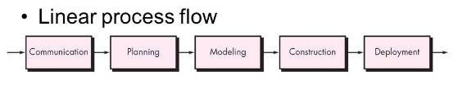
Linear Process Model:
Linear process models follow a pattern of phases completed one after another without repeating prior phases. The product is designed, developed, and released without revisiting earlier phases. This is a process which is not supporting looping within or between process phases. Process models which allow for looping are called iterative models. Linear models also require that phases be done sequentially, with no overlap between phases.

Slide 19
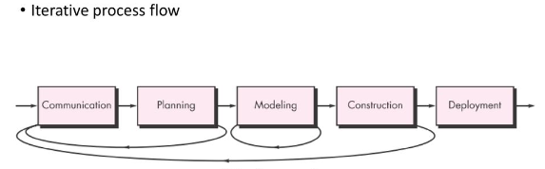
Iterative Process Model:
An iterative process is a system that you repeat until you reach your goal. Iterative processes are common in professional roles, but also in everyday life. Any time you repeat an action or learn from previous attempts, you're engaging in an iterative process. In the professional world, many companies integrate iterative processes as part of their training, project development or investing strategies.

Slide 20
SCRUM: What Is Scrum in Agile?
The Agile methodology is a widely used approach in software development and other industries where project requirements can change rapidly. One of the most popular frameworks used in Agile project management is Scrum.
Scrum is an iterative and incremental framework that helps teams deliver high-quality products in a timely manner. It is based on the principles of transparency, inspection, and adaptation, and provides a flexible and collaborative approach to project management.
Scrum was designed using a software model that follows a set of roles, responsibilities, and meetings. It can be used for any complex project but works best when the result is a concrete product rather than a service. Jeff Sutherland and Ken Schwaber are credited with creating Scrum as a framework for project management.

Slide 21
The Scrum process
Product owner: The product owner represents the customer’s best interest. This person has the ultimate authority over the final product.
Scrum master: This person is a facilitator, responsible for arranging the daily meetings, improving team interactions, and maximizing productivity. The project manager often takes on the role of Scrum master, but they can delegate it to anyone on the team who is a Scrum expert and strong facilitator.
Backlog: The backlog is a prioritized list of tasks and requirements included in the final product. It’s the responsibility of the product owner to create the backlog.
Sprint: A sprint is a set timeframe for completing each set of tasks from the backlog. Every sprint should be the same length. Two weeks is typical, but a sprint can be anywhere between one to four weeks long, depending on the team and project needs.
Daily meetings: A Scrum project team is expected to meet every day to discuss progress. These meetings are typically referred to as a daily Scrum or daily stand-up.
Review: This is a meeting where development teams show the work that was completed in an individual sprint and focus on how they can deliver a better product.
Retrospective: In the retrospective meeting, the team reviews their overall system and processes and how they can be improved for the next sprint.

Slide 22
UML Diagrams:
UML (Unified Modeling Language) is a standard language for specifying, visualizing, constructing, and documenting the artifacts of software systems.
UML diagrams are not only made for developers but also for business users, common people, and anybody interested to understand the system. The system can be a software or non-software system. Thus it must be clear that UML is not a development method rather it accompanies with processes to make it a successful system.

Slide 23
UML Diagrams:
There are many UML diagrams some of them are given as following:
Use Case Diagram
Activity Diagram
Sequence Diagram
Class Diagram

Slide 24
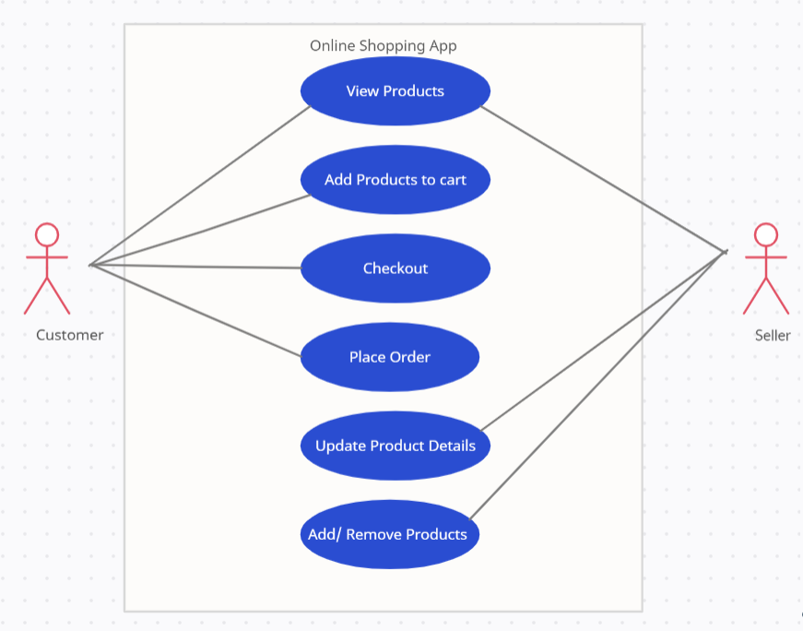
Use Case Diagram
Use-case diagrams describe the high-level functions and scope of a system. These diagrams also identify the interactions between the system and its actors. The use cases and actors in use-case diagrams describe what the system does and how the actors use it.

Slide 25
Activity Diagram
The activity diagram used to describe flow of activity through a series of actions. Activity diagram is a important diagram to describe the system.

Slide 26
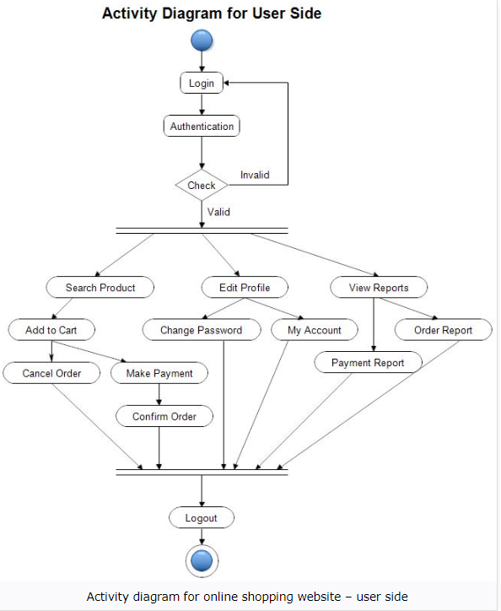
Activity Diagram

Slide 27
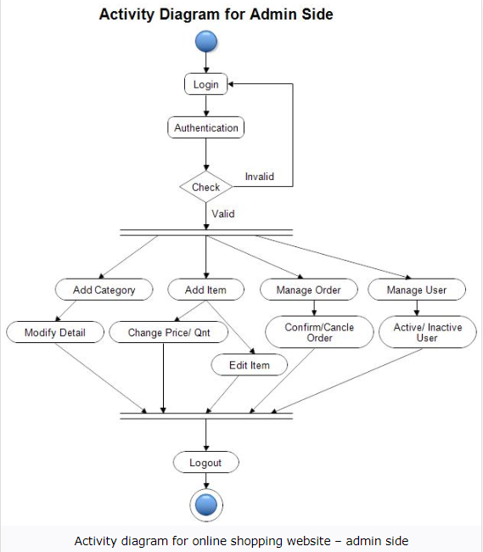
Activity Diagram

Slide 28
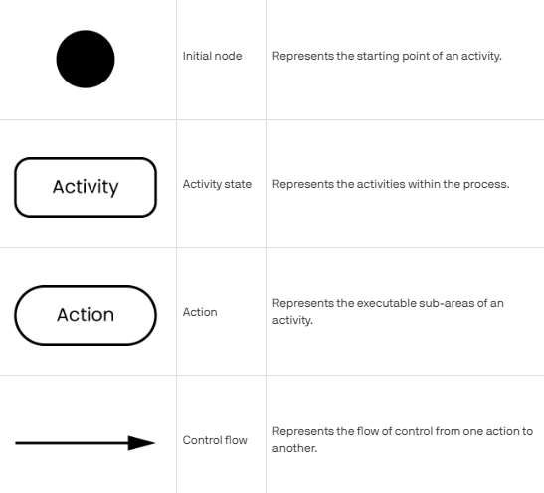
Activity Diagram

Slide 29

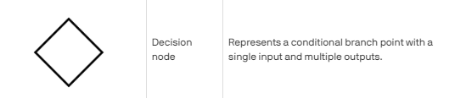
Activity Diagram

Slide 30
Sequence Diagram
The sequence diagram is used primarily to show the interactions between objects in the sequential order that those interactions occur.
Sequence Diagrams are interaction diagrams that detail how operations are carried out. They capture the interaction between objects in the context of a collaboration.
A sequence diagram is a visual representation of a series of steps that explain how a system works and how it is used in IT infrastructures. It enables the development of complex systems by showing how objects interact to accomplish a task. By showcasing the relationships between objects, users can gain insight into the workflow of events used to accomplish a goal. This type of diagram is often used to analyze and troubleshoot software, pinpoint inefficiencies, and identify potential problems. Sequence diagrams are a fundamental element in system architecture and IT infrastructure planning.

Slide 31
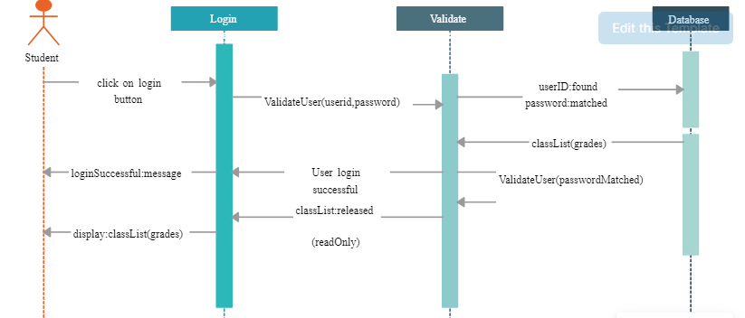
Sequence Diagram

